Slide 1







ENERGY REVOLUTION 2040

Slide 2


Presented By:
Compressed Natural Gang
Rashmi Kumari
Syed Arsalan Nadim
Ravi Raj
Rijurekh Halder

Slide 3
Topics of our Presentation
Energy Sources- Their development and contribution
1
2
Climate Change and Its Effects
3
Data Science and Its Implementation in Oil and Gas
4
Representative Graphs on current and projected future Supply and Demand of Global Energy Sector
5
Debunking Common Misconceptions regarding Depletion of Oil Reserves
z

Slide 4
So what’s the current scenario?
Coal
Oil
The Current global coal reserves are sufficient for powering our planet for next 110 years at current rate of consumption.
There are 1.65 trillion barrels of proven oil reserves in the world as of 2016
27%
33.1%
Natural Gas
Nuclear
A single 1-inch pellet of Uranium ore can provide energy equivalent to 1 ton of coal or 17000 cubic feet of Natural Gas
4.3%
24.3%
There are 6,923 trillion cubic feet (Tcf) of proven gas reserves in the world as of 2017.
Solar/Other Renewables
HydroElectric
6.4%
4.9%
Hydroelectricity is the most efficient among all renewables energy sources, functioning at 95% efficiency
If harvested at 100% efficiency, 1 hour worth of Sunlight can power our planet for a whole year.

Slide 5





TIMELINE FOR ENERGY
1859
1950-2000
2000-2020
2020+
First Oil Well dug in Pennsylvania, USA for purpose of finding Oil.
Wind farms, Nuclear Power Plants and Solar Energy Panels are introduced. Electricity replaced Steam.
Fossil Fuels dominate the Energy Market. Great advances made to increase the efficiency of non-conventional sources
Gradual shift from Fossil Fuels to Sustainable Energy sources

Slide 6
Climate Change And Its Relationship With Energy
The energy processes are the largest emitter of greenhouse gases, being responsible for 78 % of total EU emissions in 2015.
Our production and use of energy (most of which comes from fossil fuels) also contributes to climate change, accounting for more than 84% of greenhouse gas emissions.
In essence, greenhouse gas emissions related to energy can be cut in two ways: by opting for cleaner energy sources, for example by replacing fossil fuels with non-combustible renewable sources, and/or by reducing the overall consumption of energy through energy savings and energy efficiency gains, for example by improving home insulation or using greener transport modes.
Climate change can alter our energy generation potential and energy needs!

Slide 7
Climate Change And Energy Economy
Energy and climate change are often rightly linked by policymakers and politicians because, since the industrial revolution, the fossil fuels that have powered the global economy have also altered the atmosphere and are highly likely to cause climate change that may be difficult and expensive to adapt to.
In recent years, many investors announced their decisions to divest — move their investments away — from activities linked to fossil fuels.
Current and planned investments in conventional polluting technologies can actually slow down the transition towards clean energy sources. Such investment decisions can lock energy options and resources for decades, making it harder for new solutions to be adopted.
Increases in temperature will likely increase our energy demand as well as change our ability to produce electricity and deliver it reliably

Slide 8
Utility of Data Science in Oil and Gas Industry
Exploration and Discovery
Drilling Operations and Duration
Along with analysis of operation, predictions can be made with the aid of data to locate a position for drilling within the site and the expected time period for which drilling operation must be implemented
Data Science can be implemented for easier analysis of Geological domains. Facilitates easier regression of Contour lines, soil variants and topological structures. Can greatly ease the effort needed to discover new potential location enriched in fossil fuel resources.
Safety and Equipment Maintenance
Production Accounting
Data-mine of prior hindrances and accidents can be compared with trajectory of current operations and necessary measures can be taken to prevent any mishaps.
Raw production and Refinement Data can be evaluated easily with the help of Big Data. Provides easier analysis and reduces errors and risks

Slide 9
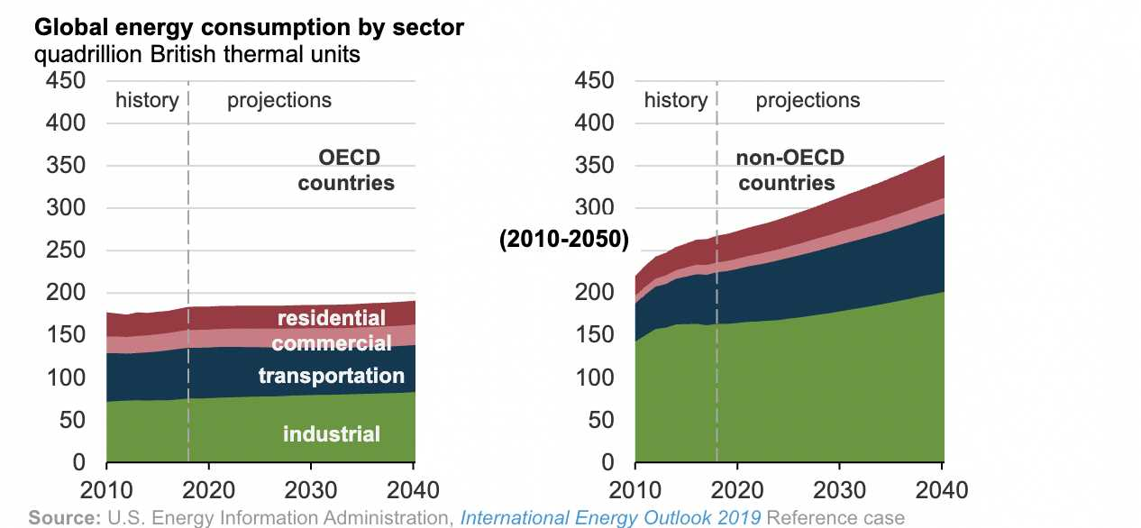
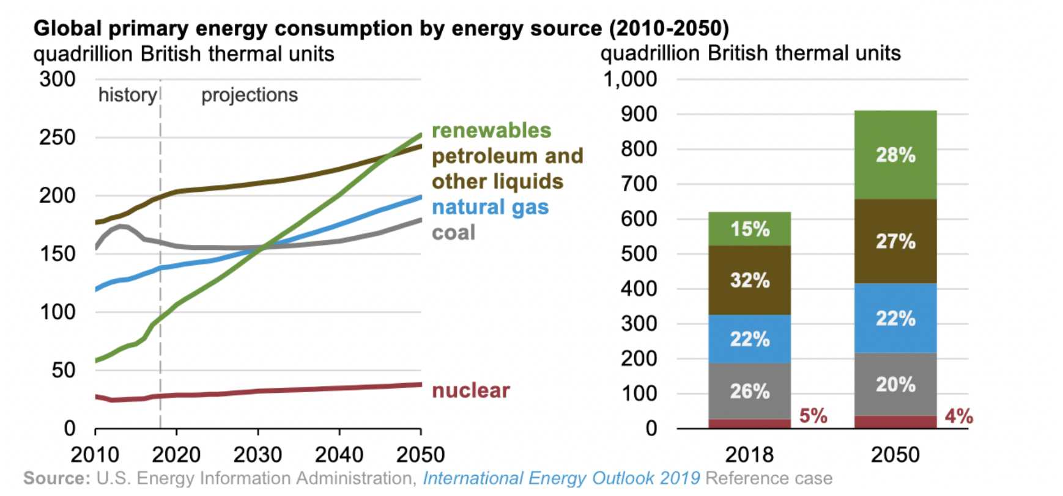
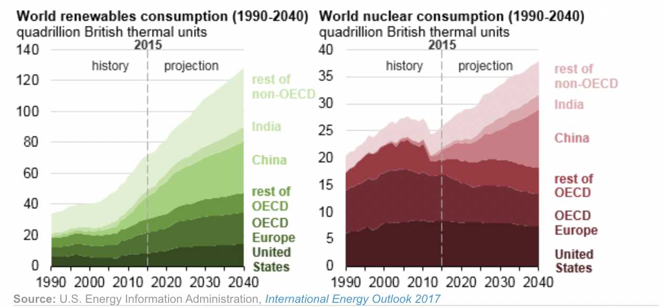
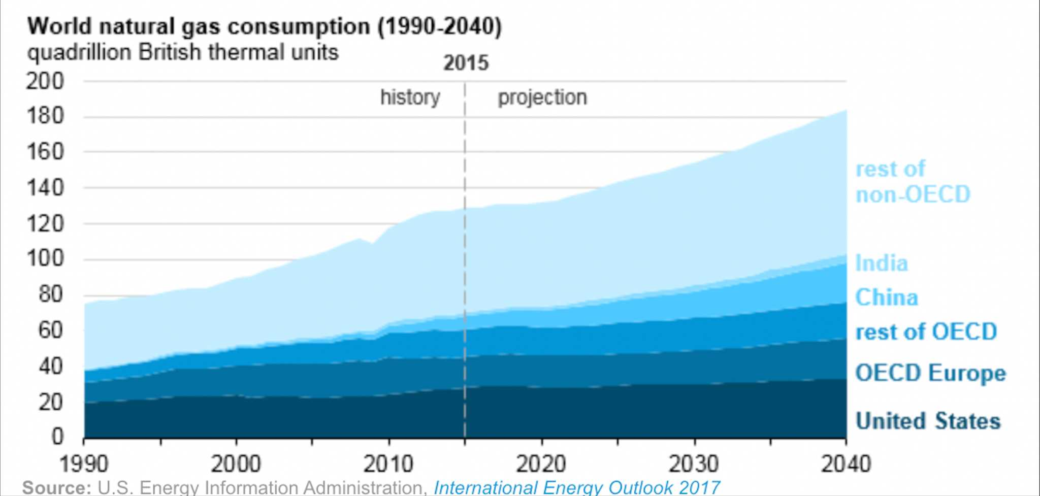
Demand

Slide 10
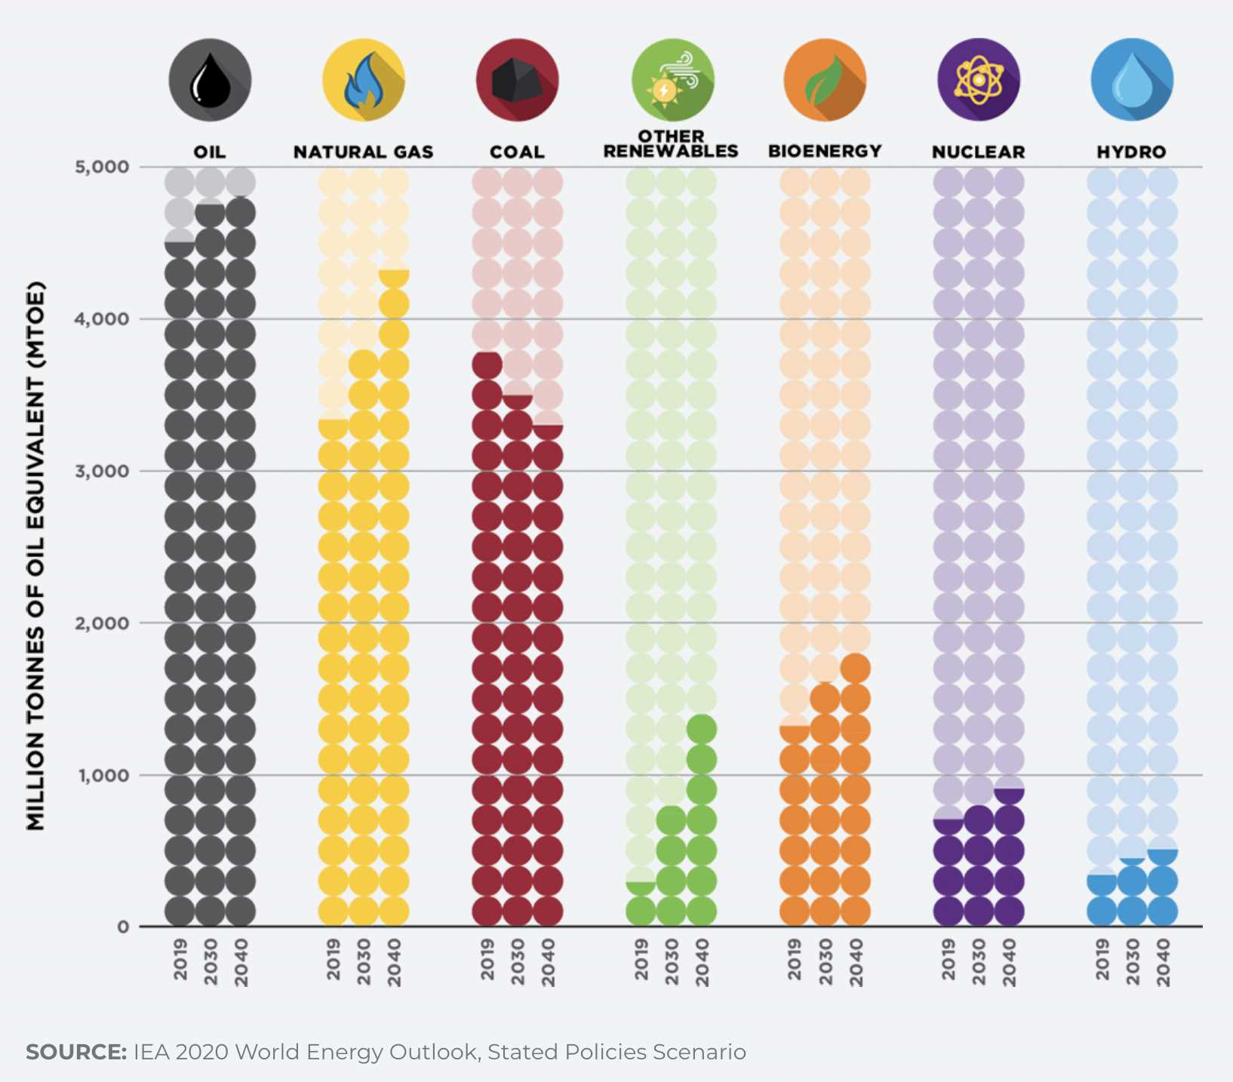
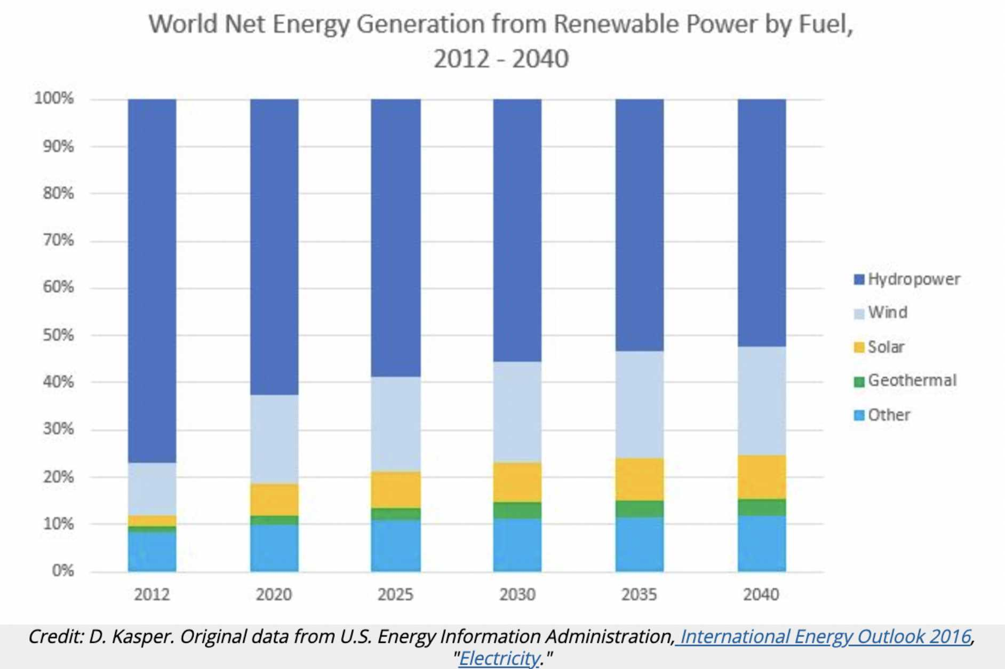
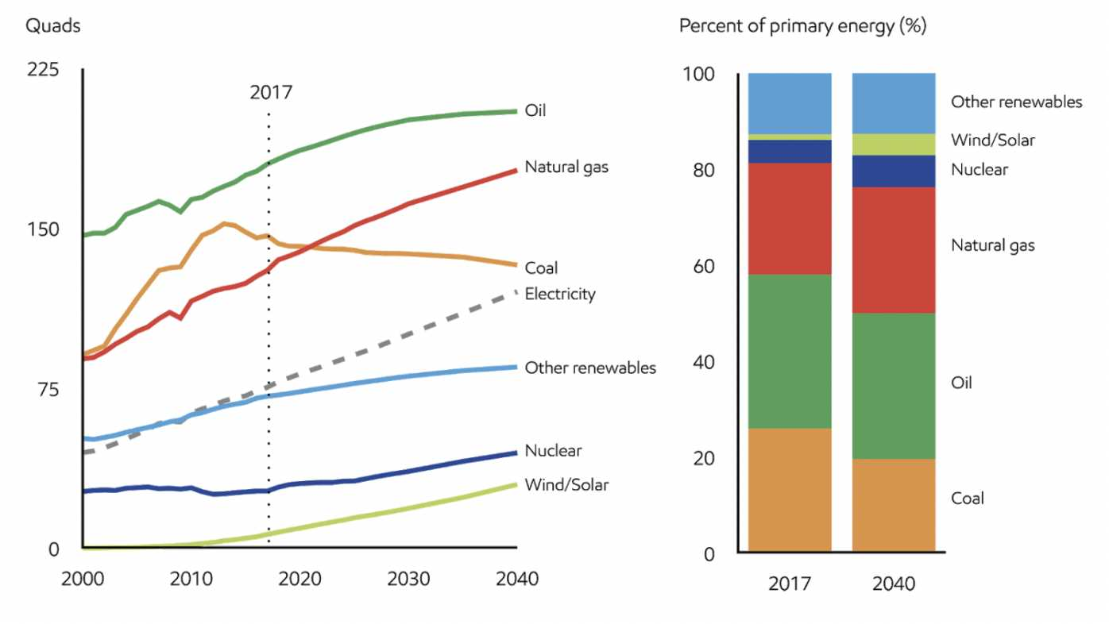
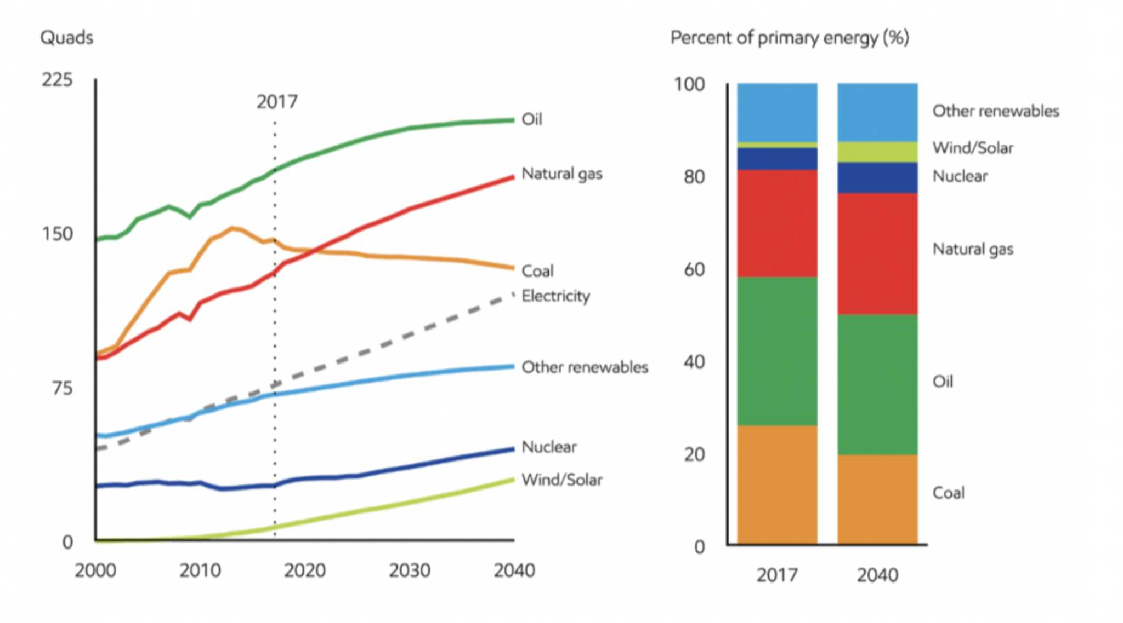
Supply

Slide 11



PROJECTED FUTURE TIMELINE (OIL AND GAS)
2025
2033
2039
2017
Oil and gas provides 54%of world energy
Global LNG regasification and liquefaction capacity doubles compared to 2019
Global CO2 emissions peak
Global gas demand peaks
Gas overtakes oil as primary energy source
Global refinery capacity reduces by 25% compared to 2019
Oil and gas provides 46% of world energy
Global oil demand peaks
2026
2036
2050
2022
Source:2019 Energy Transition Outlook model

Slide 12
So aren't we running out of oil?......Well, NO
1.Many geologists over the years have been predicting that oil would get over in the next twenty years or so.
2. The reality is however a bit more intricate. Geologists’ prediction is based on oil reserves which have already been discovered. Also many of them have been including easily accessible reservoirs.
3.Many reserves are still being discovered. A recent study from University of California at Berkeley ("Risks of the Oil Transition" by Adam Brandt and Alex Farrell, Environmental Research Letters 2006) estimated that the world has used up only about 5% of known technically recoverable oil reserve
4.Technology , to extract oil from unconventional sources, is also being developed. These resources include oil sands(Alberta), bitumen-laden "heavy oils"(Venezuela), oil shales etc.
Thus we have oil reserves for many years to come. We will slowly transition to other sources of energy not because oil is getting over but because those sources would be cheaper than oil . As summed up by Sheik Ahmed Zaki Yamani, the longtime Saudi oil minister and a key founder of OPEC
"The stone age came to an end, not for lack of stones, and the oil age will end, but not for lack of oil."

Slide 13
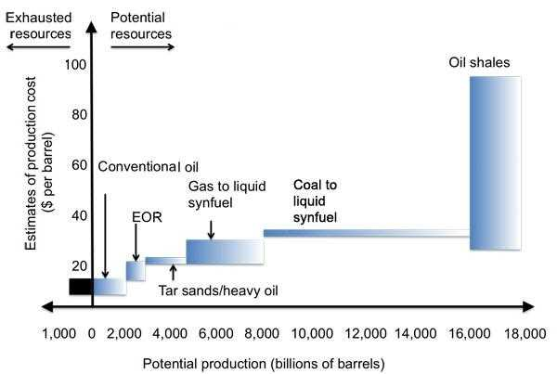
Unconventional Sources Of Oil

Slide 14
So What Does The Future Hold For Us?
Indeed, the threat of climate change looms over our head. Indeed, the anxiety of our exhaustible energy resources grips our hearts. And indeed, our insatiable hunger for energy only grows. These problems are very real and for the past century they have made themselves ever visible. But we humans are making an effort for our planet.
We are trying to make the most efficient use of our exhaustible resources, for now we are able to predict that the age of fossil fuel will propel us long enough to reach the age of Green Energy. An age where man does not need to exploit nature to fulfil his needs. An age where man can live under the kindled brilliance of human genius: for he would have harness the sun, the wind and the waves.
We would like to end by saying that while the bleak catastrophes continue to hide under the veils of future, we humans are preparing for it. Geniuses of humankind have ventured into the depths of the atom to harness the power of stars. They continue to explore and innovate: come what may, the future in our hands will remain bright.

Slide 15


